Slide 1
DNA Storage- Index Generator
Ron Maishlos
Tomer Richter Barouch
Supervisor: Omer Sabary
*Background was generated using midjourney
Notes:
https://github.com/ronm100/DNA-Indexing-project.git

Slide 2
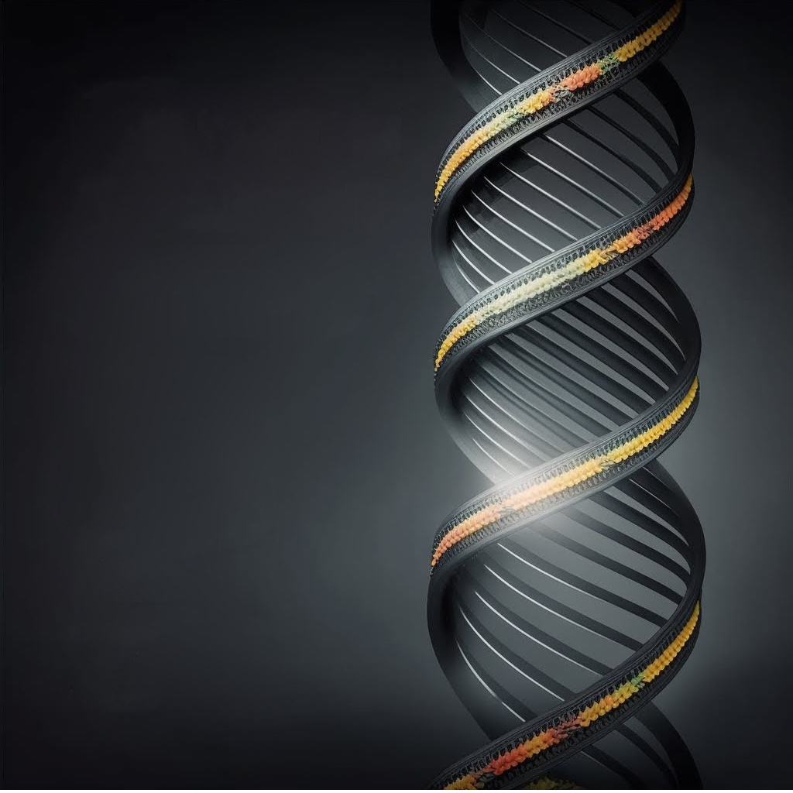
Agenda
Project Background.
Interesting modules- overview and algorithms.
Challenges and overcomes.
Results.
Conclusions.
What’s next?
DNA Storage- Index Generator
2

Slide 3
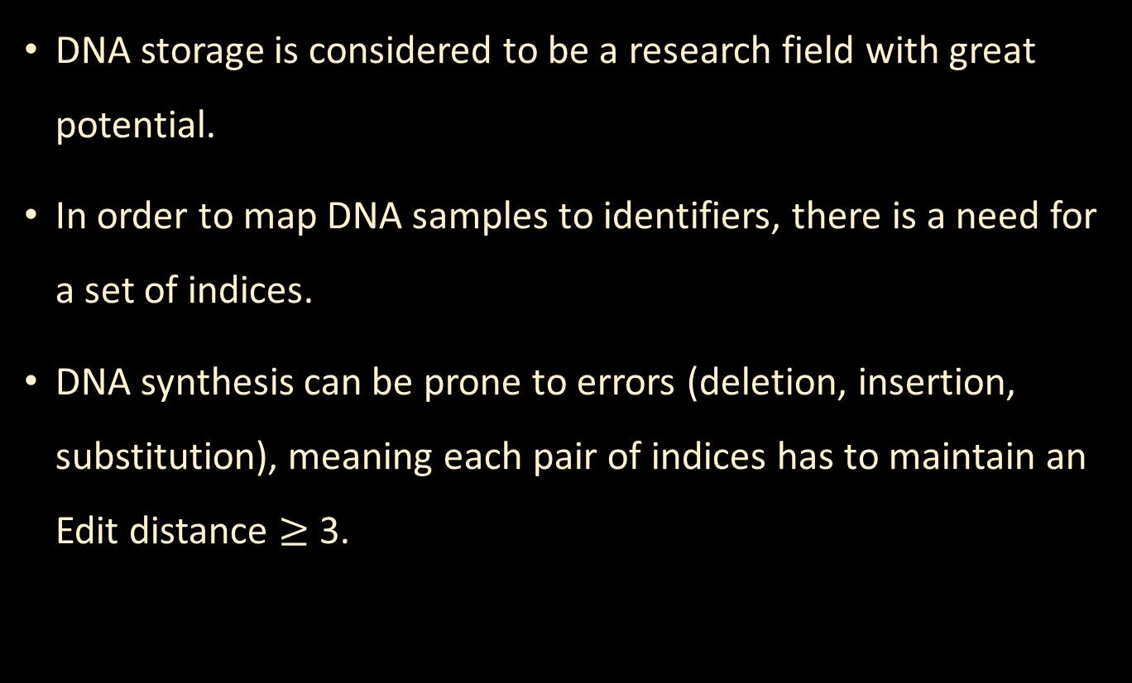
Motivation
Background
DNA storage is considered to be a research field with great potential.
In order to map DNA samples to identifiers, there is a need for a set of indices.
DNA synthesis can be prone to errors (deletion, insertion, substitution), meaning each pair of indices has to maintain an Edit distance $≥$ 3.
DNA Storage- Index Generator
3

Slide 4
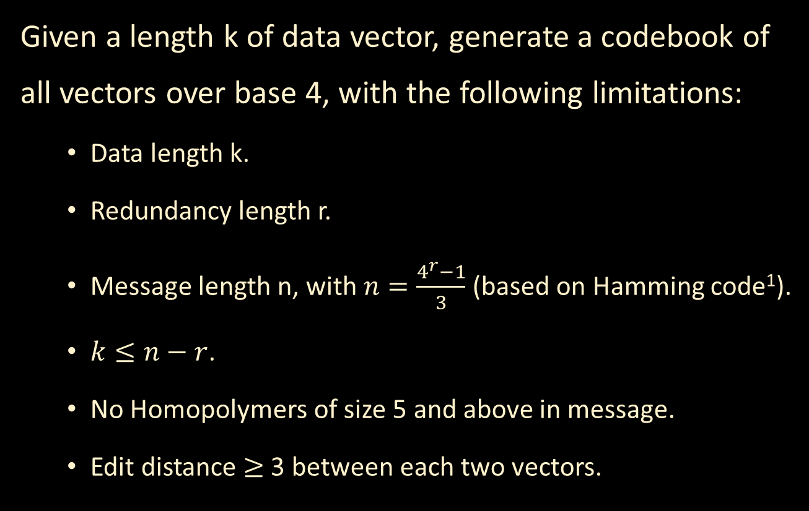
Problem Description
Background
Given a length k of data vector, generate a codebook of all vectors over base 4, with the following limitations:
  Data length k.
  Redundancy length r.
  Message length n, with $n=\frac{4^{r}−1}{3}$ (based on Hamming code¹).
  $k≤n−r$.
  No Homopolymers of size 5 and above in message.
  Edit distance $≥$ 3 between each two vectors.
DNA Storage- Index Generator
4
Notes:
[1] Chapter 4. Hamming Codes, Hall J.I, Notes on Coding Theory; https://users.math.msu.edu/users/halljo/classes/CODENOTES/Hamming.pdf

Slide 5
General Challenges
Background
Hamming VS. Edit distance:
Large Hamming Distance does not guarantee large enough Edit distance.
There is no known Generator Matrix for Edit Code.
Hamming distance = 5
1
0
0
1
0
0
1
1
10101
Edit distance = 2
1
0
1
DNA Storage- Index Generator
5
Notes:
For example: 10101 and 01010 which has Hamming distance =5 and Edit distance =2

Slide 6
Suggested Solution
Background
Get all valid Data Vectors
Data length K
Calculate Dimensions: r,n
Filter Homopolymers
Create Edit Distance matrix
Filter by distance
Code Book
Get Generator matrix
DNA Storage- Index Generator
6

Slide 7
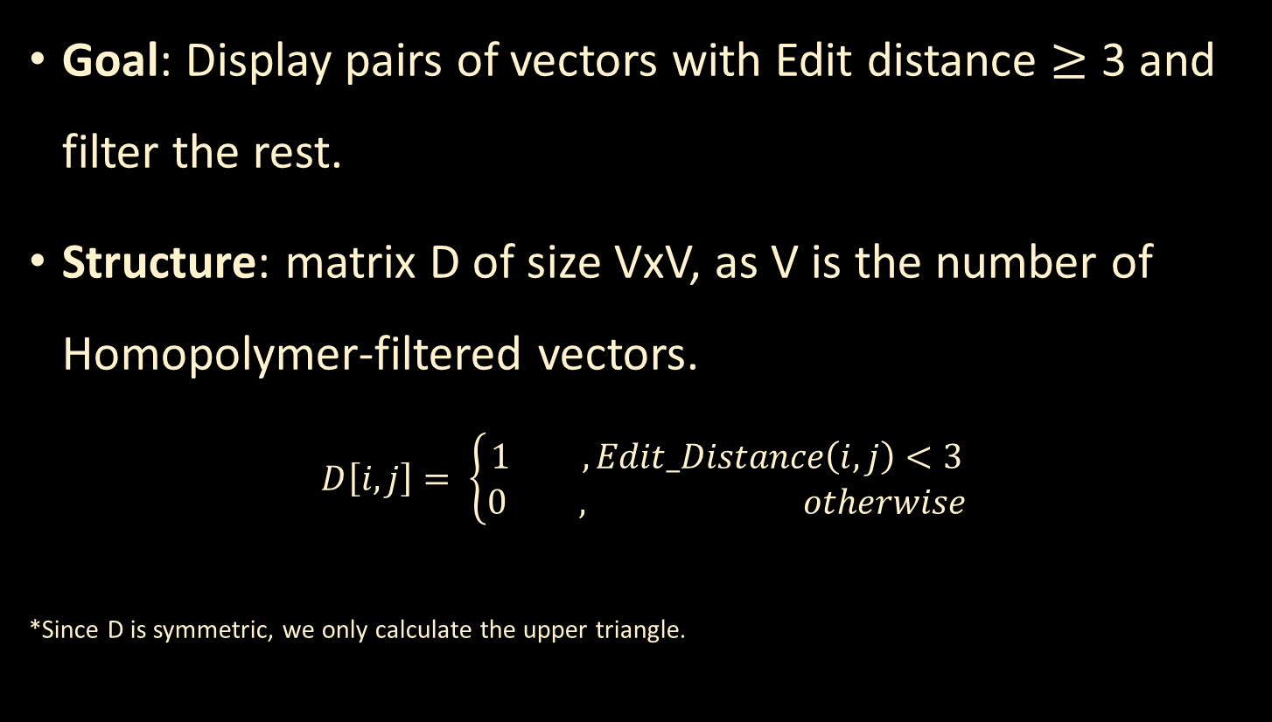
Distances Matrix Creation
Module #1
Goal: Display pairs of vectors with Edit distance $≥$ 3 and filter the rest.
Structure: matrix D of size VxV, as V is the number of Homopolymer-filtered vectors.
$$D\left[i,j\right]= \left\{\begin{matrix}1 , Edit_Distance\left(i,j\right)<3 \\ 0 , otherwise\end{matrix}\right.$$
*Since D is symmetric, we only calculate the upper triangle.
DNA Storage- Index Generator
7

Slide 8
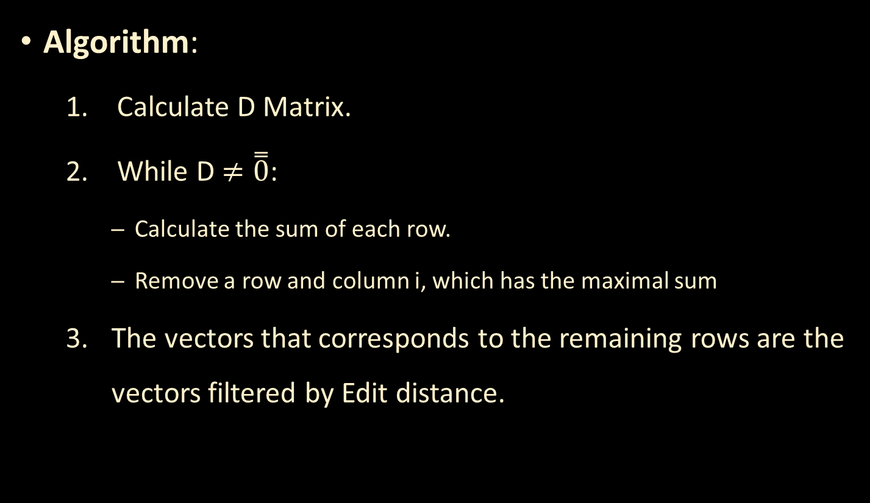
Distances Matrix Creation
Module #1
Algorithm:
  Calculate D Matrix.
  While D $≠\overset{̿}{0}$:
    Calculate the sum of each row.
    Remove a row and column i, which has the maximal sum
  The vectors that corresponds to the remaining rows are the vectors filtered by Edit distance.
DNA Storage- Index Generator
8

Slide 9
Vector Space Generator
Module #2
Goal: generate all vectors of size k over base 4 that do not contain Homopolymers of size 5 and above.
Approach: recursive DFS algorithm to traverse over the relevant branches in the DFS tree, while ignoring the “bad” branches.
0
…
0
0
…
0
…
0
1
…
0
…
DNA Storage- Index Generator
9

Slide 10
Challenges
Challenges & Overcomes
  Due to insufficient computing power, we only managed to acquire ~3 billion vectors in the primary filtering of the DFS. This result is ~22 times smaller than the actual filtered vector space → results may be biased.
DNA Storage- Index Generator
10

Slide 11
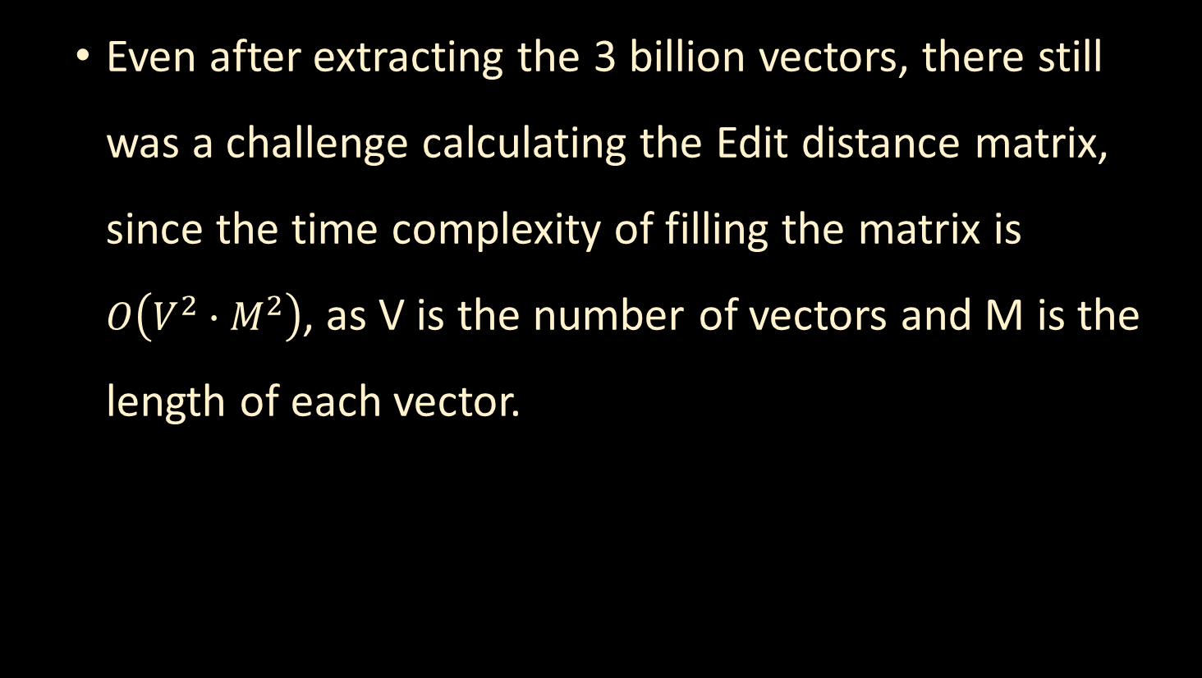
Challenges
Challenges & Overcomes
  Even after extracting the 3 billion vectors, there still was a challenge calculating the Edit distance matrix, since the time complexity of filling the matrix is $O\left(V^{2}∙M^{2}\right)$, as V is the number of vectors and M is the length of each vector.
DNA Storage- Index Generator
11

Slide 12
Overcomes
Challenges & Overcomes
POC over ~50,000 vectors. That way, calculating the matrix was done in decent time.
Using multi-process parallelism for calculating the Edit distance between each two vectors.
DNA Storage- Index Generator
12

Slide 13
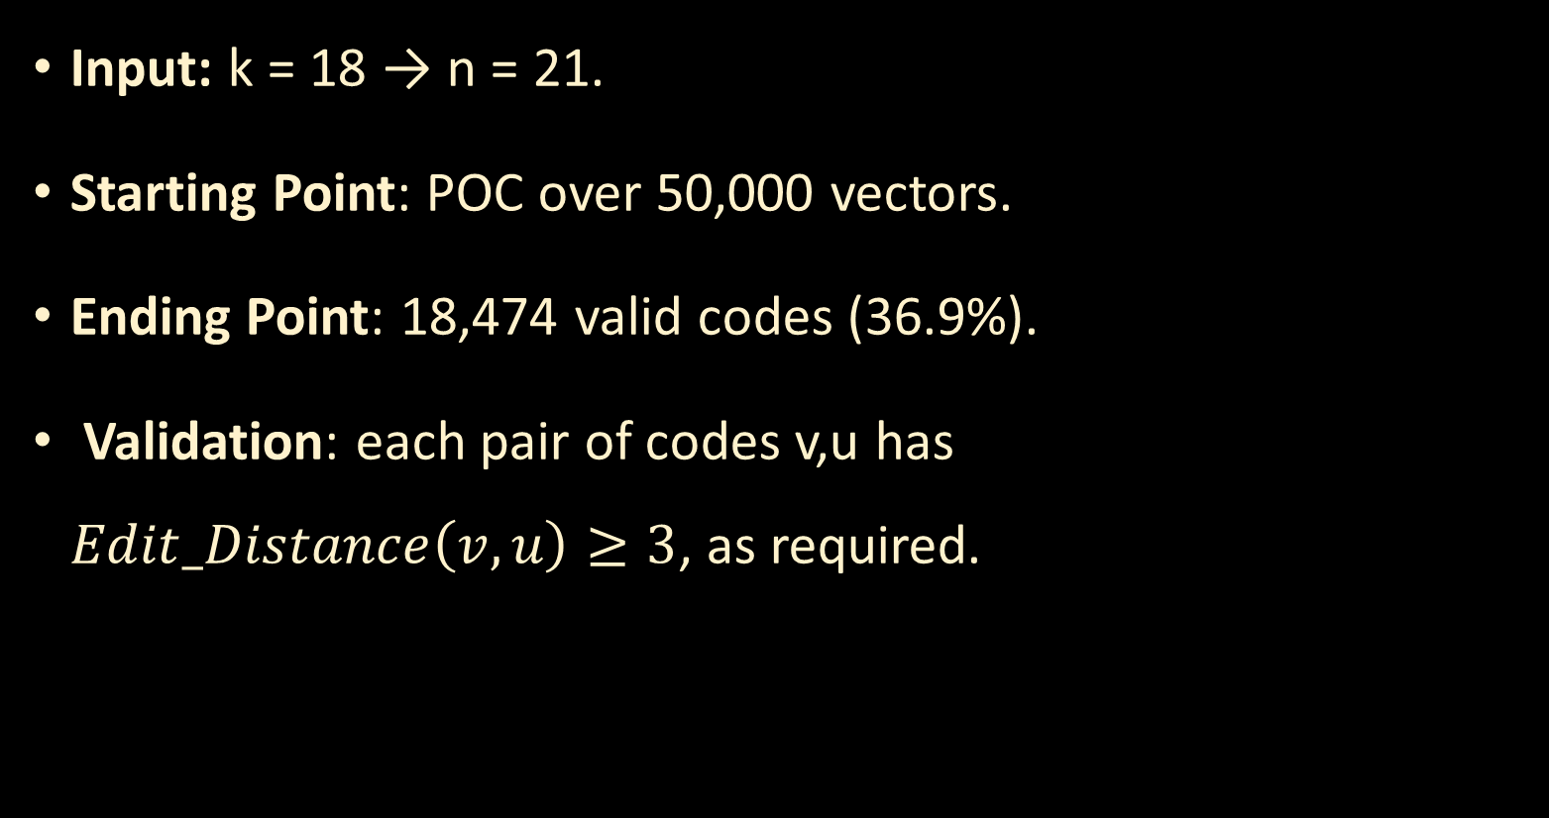
Results
Results
Input: k = 18 → n = 21.
Starting Point: POC over 50,000 vectors.
Ending Point: 18,474 valid codes (36.9%).
Validation: each pair of codes v,u has $Edit_Distance\left(v,u\right)≥3$, as required.
DNA Storage- Index Generator
13

Slide 14
Conclusions
Conclusions
Proof: valid tool to generate Code Book with the required conditions.
Bottleneck: calculating Edit distance between large group of codes is inefficient.
Data Analysis: use NumPy’s vectorized functions and methods to increase efficiency.
On a personal level, Thank you- Omer and Daniella! we had lots of fun working on the project and learned so much from the process.
DNA Storage- Index Generator
14

Slide 15
What’s Next?
Further Work
Finish generate the vectors using the DFS and apply the full solution over them.
Apply different methods for optimizing the code book, i.e.: removing different columns from the Generator matrix.
Research for efficient methods to generate Edit distance-based codes.
Assimilate the Code Book in the general project.
DNA Storage- Index Generator
15
Notes:
Tomer

Slide 16
Thanks for listening!
DNA Storage- Index Generator
16

Slide 17
Questions?
DNA Storage- Index Generator
17

